Slide 1
EUMETSAT’s Copernicus activities
26th North America / Europe Data Exchange Meeting (NAEDEX-26)
14th Asia / Pacific Satellite Data Exchange and Utilisation Meeting (APSDEU-14)
Montreal, Canada, 06 – 09/10/2015
Susanne Dieterle and Simon Elliott, EUMETSAT

Slide 2
EUMETSAT ambition in support to Copernicus services
Being an operational, user driven and service-oriented organisation, the goal of EUMETSAT is to deliver to Copernicus users:
a single multi-mission real-time data stream
which integrates meteorological and ocean / atmosphere products
including cross-calibrated data between Sentinels and EUMETSAT satellites
using existing EUMETSAT infrastructure (operations, dissemination , archive,…)
This data service provision will rely on:
EUMETSAT satellites (Meteosat, Metop, Jason)
Copernicus Sentinels operated by EUMETSAT (S-3, S-4, S-5 and S-6/Jason CS satellites )
Satellites of third-parties with whom EUMETSAT have cooperation agreements (e.g. NOAA, CMA, ISRO, etc)

Slide 3
EUMETSAT activities in support of Copernicus
The activities that EUMETSAT will undertake in support to Copernicus are organised along 5 main activities or Building Blocks.
Building Block I
Operations and delivery of data and operational services to Copernicus Marine Service
Building Block II
Operations and delivery of data and operational services to Copernicus Atmosphere Service
Building Block III
Selected Mission Data services, incl. Third Party data
Building Block IV
Support to Copernicus Climate Change service
Building Block V
Support to EC for User Requirements for Copernicus Marine, Atmosphere and Climate Services
Building Blocks I to III are committed under agreement.

Slide 4
Scope of the Copernicus operational activities at EUMETSAT
EUMETSAT negotiated with the EC an Agreement including the following operational tasks:
Operation and maintenance of space segment for Sentinel-3, Sentinel-4 (instrument on-board MTG), Sentinel-5 (Instrument on-board EPS-SG), Sentinel-6 (Jason-CS satellite).
Ground Segment operation and provision of data and product services to the Marine, Atmosphere and Climate change services (Jason-3, Sentinel-3 marine, Sentinel-4, Sentinel-5 and Sentinel-6);
Maintenance and evolution of the related ground functions and infrastructure as a response to evolving user needs;
Provision of relevant data from EUMETSAT and Third-Party missions related to the Marine, atmosphere and Climate Change Services;
Support to the development, launch and LEOP of the recurrent satellites or instruments;

Slide 5
Future Missions – Sentinels for Copernicus
Most of the Sentinel missions are based on a constellation of two satellites to fulfill revisit and coverage requirements, providing robust datasets for Copernicus Services.
These missions carry a range of technologies, such as radar and multi-spectral imaging instruments for land, ocean and atmospheric monitoring. The Sentinels in which EUMETSAT is involved are:
Sentinel-3 is a multi-instrument mission to measure sea-surface topography, sea- and land-surface temperature, ocean colour and land colour with high-end accuracy and reliability. The mission will support ocean forecasting systems, as well as environmental and climate monitoring. Foreseen launch is 10 December 2015.
Sentinel-4 is a payload devoted to atmospheric monitoring that will be embarked upon a Meteosat Third Generation-Sounder (MTG-S) satellite in geostationary orbit.
Sentinel-5 is a payload that will monitor the atmosphere from polar orbit aboard a Metop Second Generation satellite.
Sentinel-6 carries a radar altimeter to measure global sea-surface height, primarily for operational oceanography and for climate studies. It is a follow-on of the Jason missions, and is implemented through the Jason-CS (Continuity of Service) space segment.

Slide 6
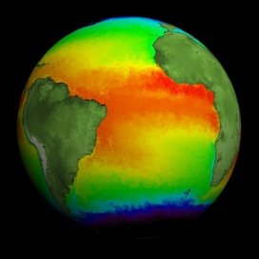
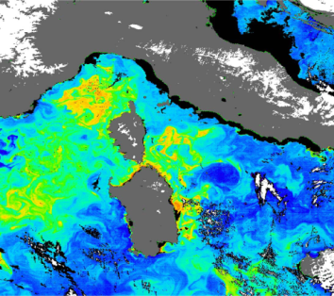
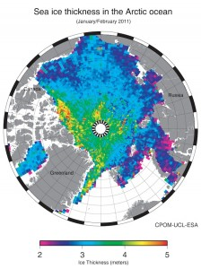
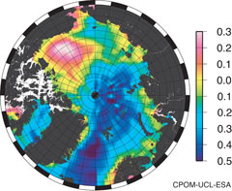
Sentinel-3 Marine product contents
Level 1B (ESA and EUMETSAT)
- SLSTR – Sea and Land Surface Temperature Radiometer
OLCI – Ocean and Land Colour Instrument
SRAL - SAR Radar Altimeter
Level 2 SLSTR:
Sea surface temperature
(L2P GHRSST standard)
Level 2 SRAL:
Sea/coastal zone surface height
Significant wave height
Wind speed
Backscatter coefficient s₀
Sea ice height, freeboard
Total water, liquid water (from MWR)
Level 2 OLCI:
Normalised water surface reflectance
Algal pigment concentration for open and for coastal waters
Total suspended matter concentration
Diffuse attenuation coefficient
Coloured dissolved matter absorption
Photosynthetically active radiation
Integrated water vapour
Aerosol optical depth
Aerosol Angström exponent

Slide 7
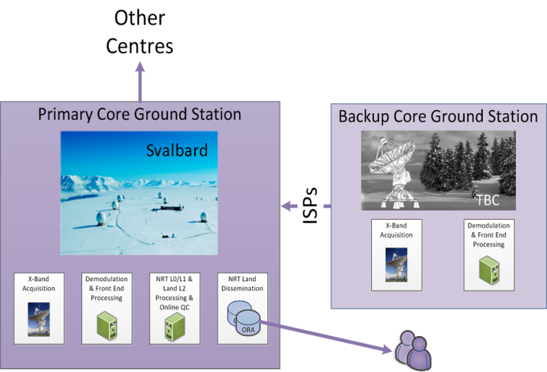
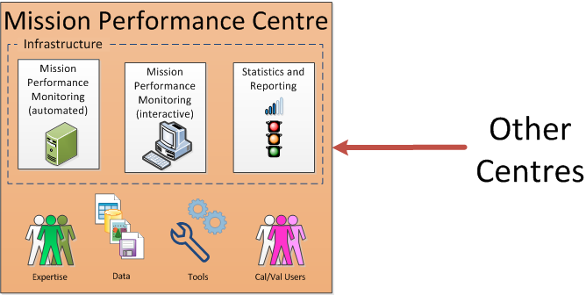
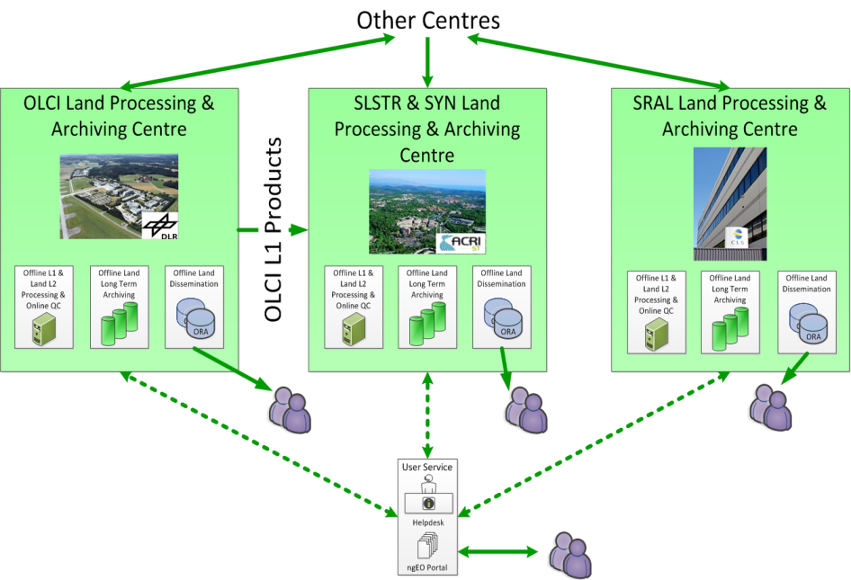
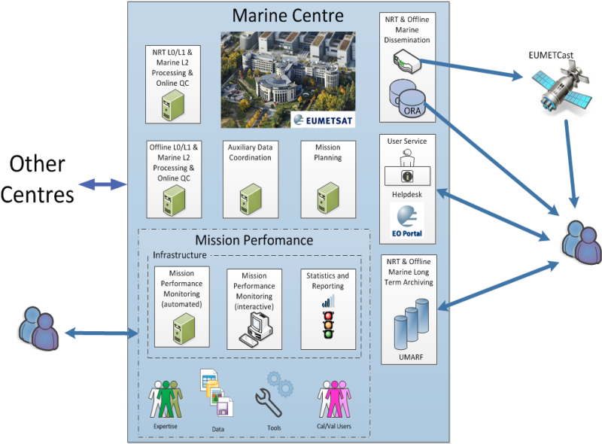
Copernicus Sentinel-3 Payload Data Ground Segment - Overview
Product Dissemination Units (PDUs) apply to both EUMETCast and ODA/ORA dissemination
Online Rolling Data Archive (ODA/ORA): Supports ftp/http access to level 1&2 PDUs over the Internet

Slide 8
Copernicus Sentinel-3 Payload Data Ground Segment - Elements
The Payload Data Ground Segment (PDGS) provides functions for Instrument Science Data acquisition, processing (and reprocessing), calibration, mission planning, archiving, user services and dissemination to the users
The overall mission management being under ESA responsibility
PDGS functions (facilities) are hosted in the following Centres:
The Marine PDGS Centre and Land PDGS Centre respectively under EUMETSAT and ESA responsibility
The X-Band Core Ground Station(s) Centre(s) under ESA responsibility
The Precise Orbit Determination (POD) facilities comprising:
The Near-Real-Time (NRT) POD processing, (part of the PDGS)
The Offline Processing centre which encompasses Short-Time-Critical (STC) and Non-Time-Critical (NTC) POD
The EUMETSAT Marine PDGS Centre includes the following facilities:
Near Real Time (NRT) and Offline (STC, NTC) processing: L0, L1 and L2 Marine product generation, Archiving, and Dissemination, to Users
Marine Mission Performance
Mission Planning providing FOS/MPS with instruments operation requests
Handling of all communications with PDGS Centres and External interfaces

